Slide 1
Graph Algorithms:
Maximum Flow

Slide 2
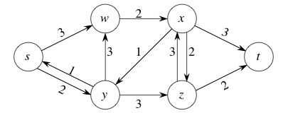
Flow Network
Directed graph G = (V, E) with non-negative edge weights c : E -> R
  c(u, v): nonnegative capacity of an edge (u, v) ∈ E
    c(u, v) = 0 if (u, v) ∉ E
  s: source of the network
  t: sink of the network

Slide 3
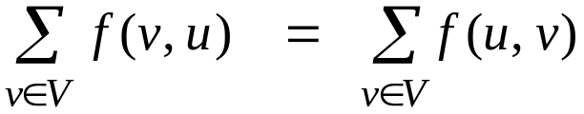
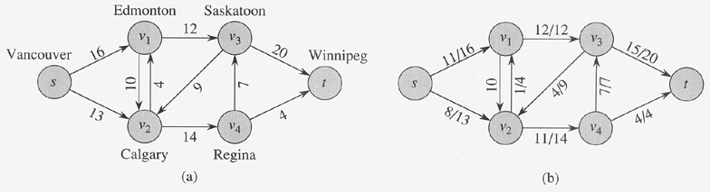
Flow Network
A positive flow is a function f:V × V → R s.t.,
  Capacity constraint:
    For all u, v ∈V, 0 ≤ f(u, v) ≤ c(u, v)
  Flow conservation constraint:
    For all u ∈V - {s, t},
Flow in equals flow out

Slide 4
Maximum-Flow Problem
Given a flow f, the value of f is
  | f | = ∑ f (s, u) : i.e., total flow out of the source
Maximum-flow problem:
  Compute a flow of maximum value
Multiple sources/sinks
  Convert to single source/sink problem by adding one supersource and one supersink
Anti-parallel edges
  Transform the network into an equivalent one containing no anti-parallel edges by adding a new vertex

Slide 5
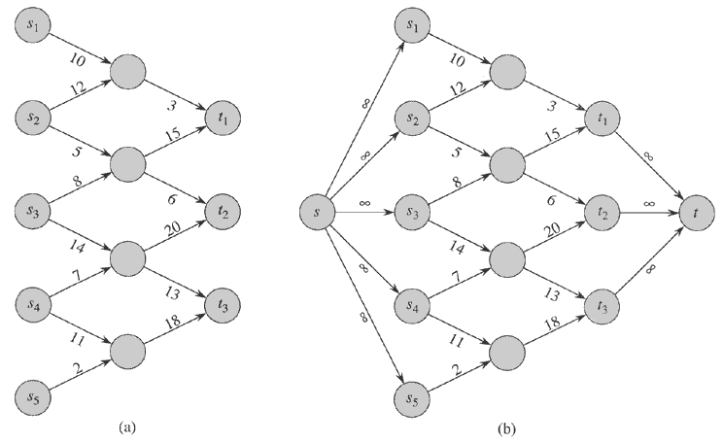
Maximum-Flow Problem

Slide 6
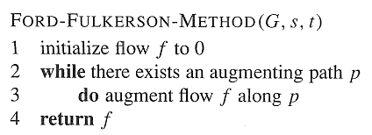
Maximum-Flow Problem

Slide 7
Residual Network
Given a flow network and a flow, the residual network consists of edges that can admit more network flow.
G = (V, E): a flow network with source s and sink t
f : a flow in G
The amount of additional network flow from u to v before exceeding the capacity c(u, v) is the residual capacity of (u, v), given by: c_{f} (u, v) = c(u, v) – f (u, v)

Slide 8


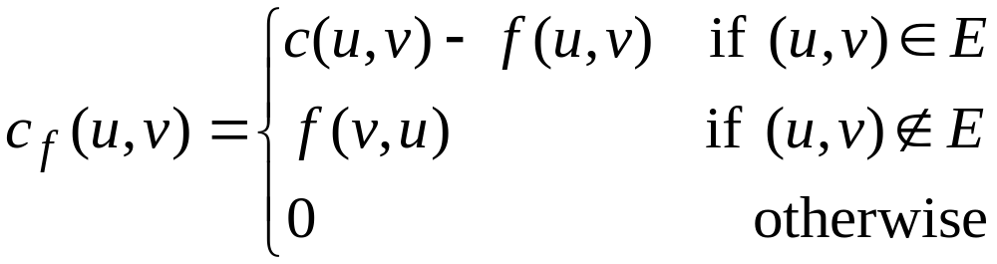
Residual Network
Given a flow f in a network G = (V, E)
  The residual capacity between u, v ∈ V
  Residual network G_{f} = (V, E_{f} )
    where
  Residual network G_{f} may also contain edges that are not in G
  Residual capacity, c_{f} (u, v) is defined by
≥ 0 !

Slide 9
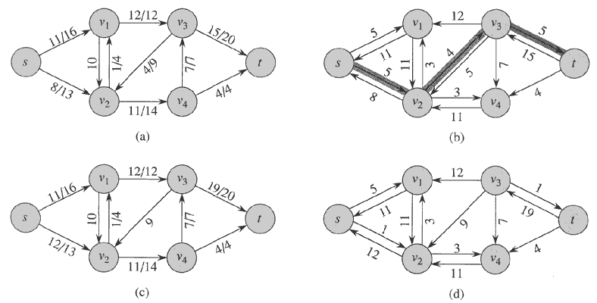

Residual Network: Example
Each edge in G corresponds to at most two
edges in residual network:

Slide 10
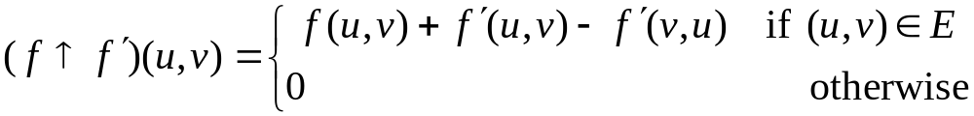
Residual Network
A flow in a residual network provides a roadmap for adding flow to the original flow network.
  If f is a flow in G and f’ is a flow in G_{f} , we define f ↑ f’, the augmentation of flow f by f’
Pushing flow on the reverse edge in the residual network is known as cancellation.

Slide 11
Residual Network
Lemma
  Let G = (V, E) be a flow network with source s and sink t, and let f be a flow in G.
  Let G_{f} be the residual network of G induced by f, and let f’ be a flow in G_{f} . Then the flow sum f+f’ is a flow in G with value | f + f’ | = | f | + | f’ |
  f + f’ : the flow in the same direction will be added.
the flow in different directions will be cancelled.
This suggests that we can improve current
flow by computing a new flow for its
residual network, and add it upon original one

Slide 12
Augmenting Path
Given a flow f in a flow network G = (V, E), an augmenting path p is a simple path from source s to sink t in the residual network G_{f}.
How much extra flow can we push on an augmenting path p ?
The maximum amount by which we increase the flow on each edge in an augmenting path p is the residual capacity of p, given by
c_{f} (p) = min{c_{f} (u, v) : (u, v) is on p}
2
3
5
The residual capacity is 2

Slide 13
Augmenting Path: Example

Slide 14
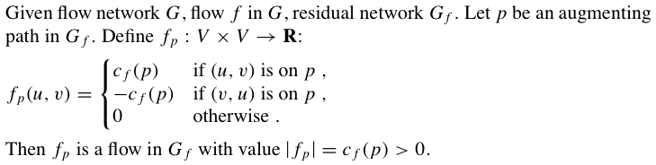

Lemma: Augmenting -> Flow
Lemma:
Corollary:

Slide 15
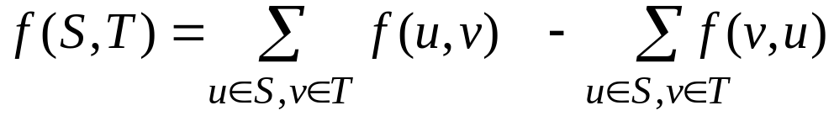
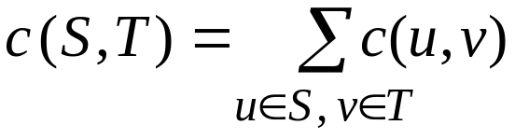
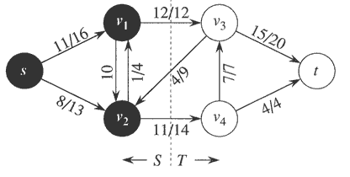
Cuts of Flow Networks
A cut (S, T) of flow network G = (V, E)
  is a partition of V into S and T = V - S, s.t. s ∈ S and t ∈ T
  The net flow f (S, T) across cut (S, T) is
  The capacity c(S, T) of cut (S, T) is
A minimum-cut is a cut whose capacity is minimum over all cuts
f (S, T) = 12 + 11 - 4 = 19
c (S, T) = 12 + 14 = 26

Slide 16
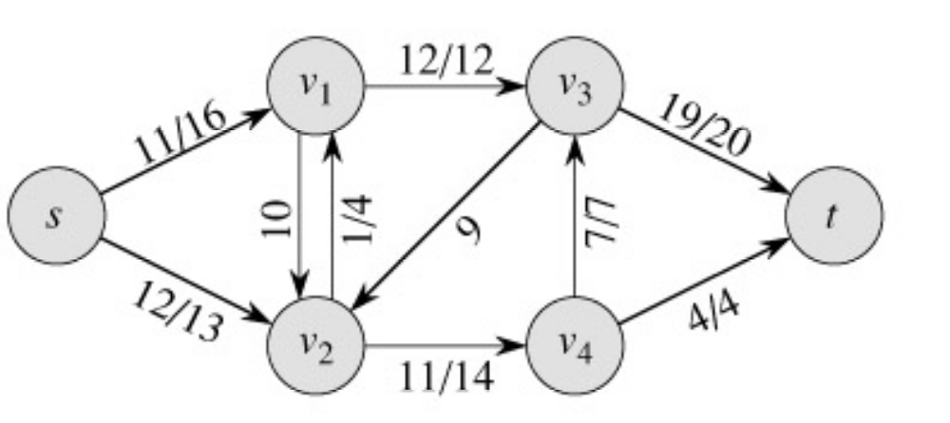
Cuts of Flow Networks
The net flow across any cut is the same and equal to the flow of the network |f|.

Slide 17
Cuts of Flow Networks
Lemma:
Let f be a flow in a network G with source s and sink t, and let
(S, T) be a cut of G. Then the net flow across (S, T) is f (S, T) = | f |.
Corollary:
The value of any flow f in a flow network G is bounded from above by the capacity of any cut of G.
The value of any flow ≤ the capacity of any cut

Slide 18
Max-flow Min-cut Theorem
If f is a flow in a flow network G = (V, E ) with source s and sink t, then the following conditions are equivalent:
  (1) f is a maximum flow in G
  (2) The residual network G_{f} contains no augmenting paths
  (3) | f | = c (S, T ) for some cut (S, T ) in G
Proof:
  (1) => (2)
  (2) => (3)
  (3) => (1)

Slide 19
Ford-Fulkerson Algorithm
FORD-FULKERSON(G, s, t)
for each edge (u, v) ∈ E[G] do
f [u, v] = 0
f [v, u] = 0
while there exists a path p from s to t in the residual network G_{f} do
c_{f} (p) = min{c_{f} (u, v): (u, v) is in p}
for each edge (u, v) in p do
if (u, v) ∈ E[G]
f [u, v] = f [u, v] + c_{f} (p)
else f [v, u] = f [v, u] – c_{f} (p)
O(E)
?
O(E)

Slide 20
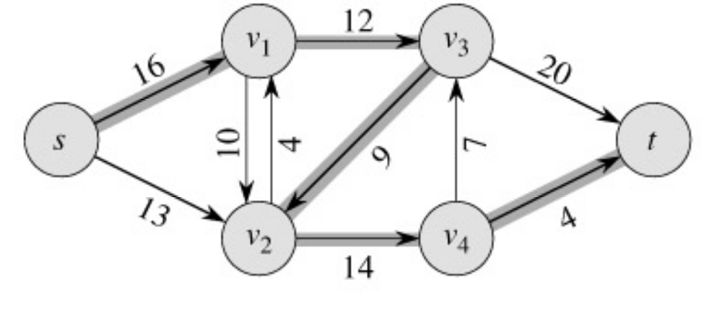
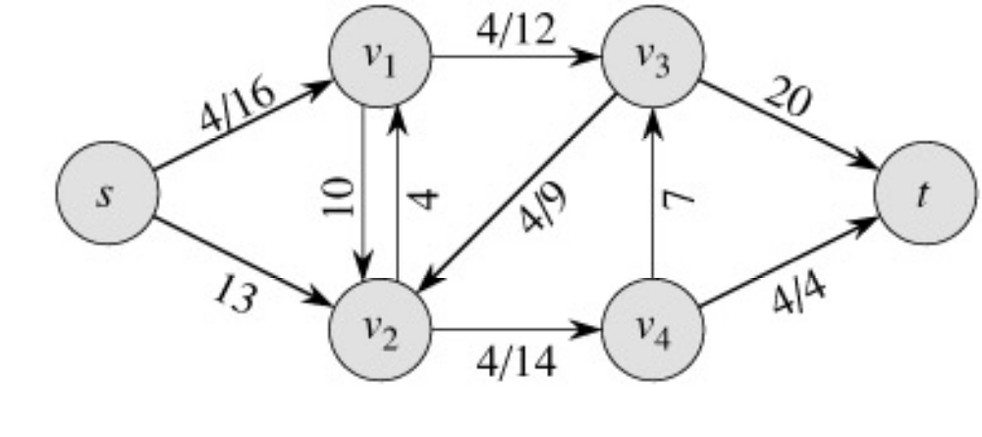
Ford-Fulkerson Algorithm: Example
augmenting path
Original Network
Flow Network
Resulting Flow =
4

Slide 21
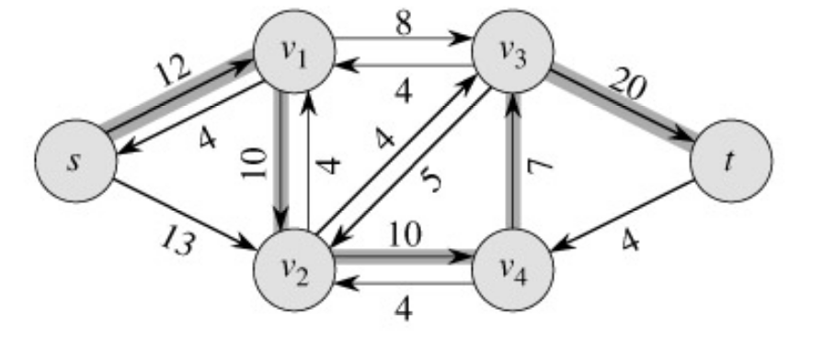
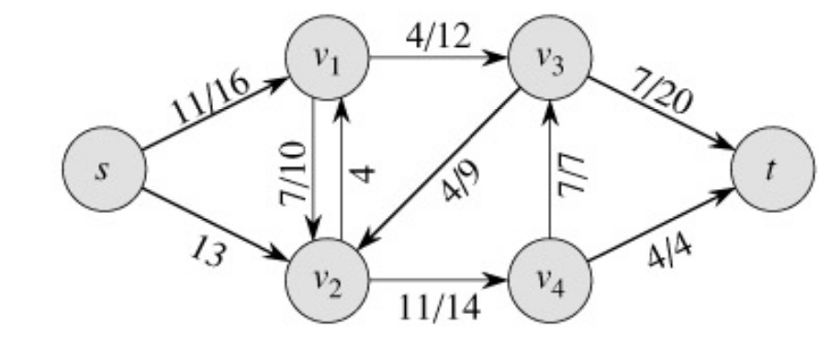
Ford-Fulkerson Algorithm: Example
Resulting Flow =
Flow Network
4
augmenting path
Residual Network
Flow Network
Resulting Flow =
11

Slide 22
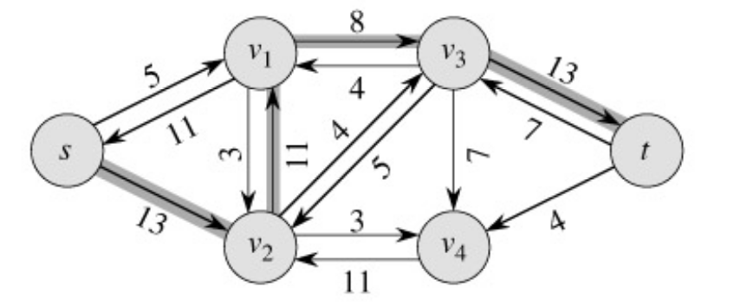
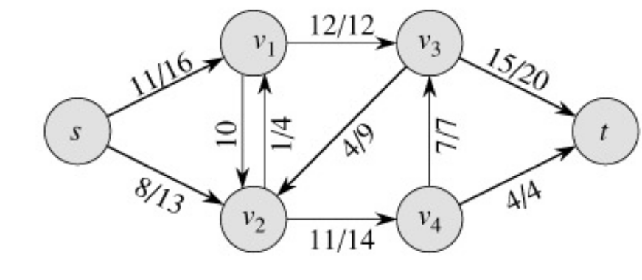
Ford-Fulkerson Algorithm: Example
Flow Network
Resulting Flow =
11
augmenting path
Residual Network
Flow Network
Resulting Flow =
19

Slide 23
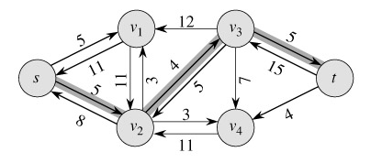
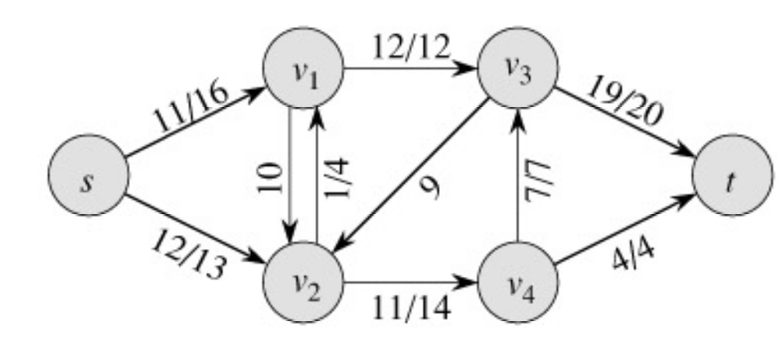
Ford-Fulkerson Algorithm: Example
Flow Network
Resulting Flow =
19
augmenting path
Residual Network
Flow Network
Resulting Flow =
23

Slide 24
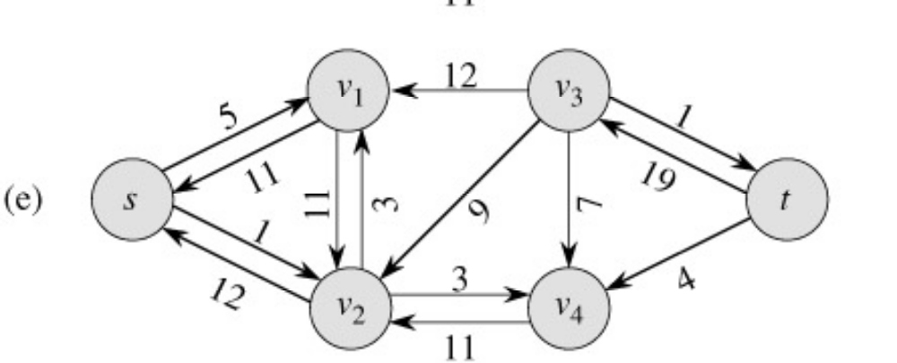
Ford-Fulkerson Algorithm: Example
Resulting Flow =
23
No augmenting path:
Maxflow = 23
Residual Network

Slide 25
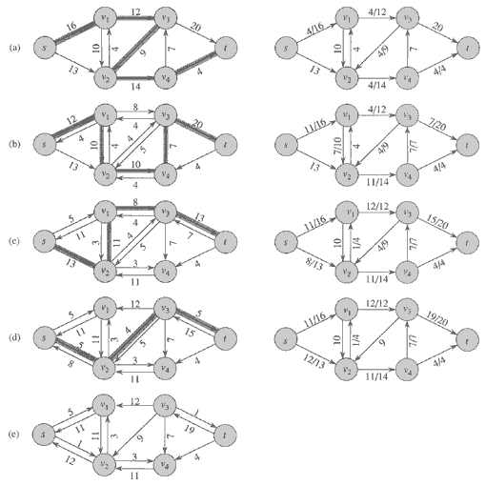
Ford-Fulkerson Algorithm: Example

Slide 26
Ford-Fulkerson Algorithm: Analysis
Performance obviously
  depends on the augmenting paths found at each iteration
If edge capacities are integers (or, rational numbers [apply an appropriate scaling transformation to make them all integral]):
  Then the algorithm returns max-flow
  The algorithm runs in polynomial time
If edge capacities are irrational numbers:
  Then the algorithm might not even terminate
  It need not even converge to the maximum value

Slide 27
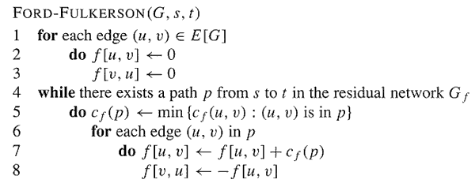
Ford-Fulkerson Algorithm: Integral Capacities
If each c(e) is an integer, then time complexity is O(E | f *|), where f * is the maximum flow found by the algorithm
  Lines 1-3 take O(E) time.
  The while loop of Lines 4-8 is executed at most | f *| times, since the value of the flow increases by at least 1 at each iteration.
    Each iteration of the while loop takes O(E) time if either depth-first or breadth-first search is used to find a path in the residual network.
  Therefore, total time = O(E + E | f *|) = O(E | f *|).

Slide 28
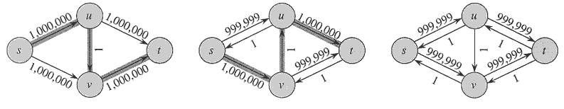
Ford-Fulkerson Algorithm: Integral Capacities
Ford-Fulkerson algorithm runs in O(E | f *|) time, where f * is the maximum flow found by the algorithm
Not really polynomial in |V| and |E|
  Depends on | f *|

Slide 29
Edmonds-Karp Algorithm
A small fix to the Ford-Fulkerson algorithm makes it work in polynomial time.
Select the augmenting path using breadth-first search on residual network.
The augmenting path p is the shortest path from s to t in the residual network (treating all edge weights as 1).
Runs in time O(V E²).

Slide 30
Edmonds-Karp Algorithm
Use the Ford-Fulkerson framework
Implement the computation of augmenting path
  by using breadth-first search
  i.e, a shortest-linkage path (in no. of edges) from s to t in residual network
Enable us to bound the time complexity
  Mainly: the number of iterations
Time complexity of Edmonds-Karp algorithm is O(V E²)
  The number of iterations is O(V E)
  Each iteration needs O(E)

Slide 31
Edmonds-Karp Algorithm: Observations
Lemma: If the Edmonds-Karp algorithm is run on a flow network G = (V, E) with source s and sink t, then for all vertices v ∈ V – {s, t}, the shortest distance δ_{f} (s, v) in the residual network G_{f} increases monotonically with each flow augmentation.
Proof:
Theorem: If the Edmonds-Karp algorithm is run on a flow network G = (V, E) with source s and sink t, then the total number of flow augmentations performed by the algorithm is O(V E).
Proof:
Time complexity of Edmonds-Karp algorithm is O(V E²)

Slide 32
An Application of Max Flow:
Maximum Bipartite Matching

Slide 33
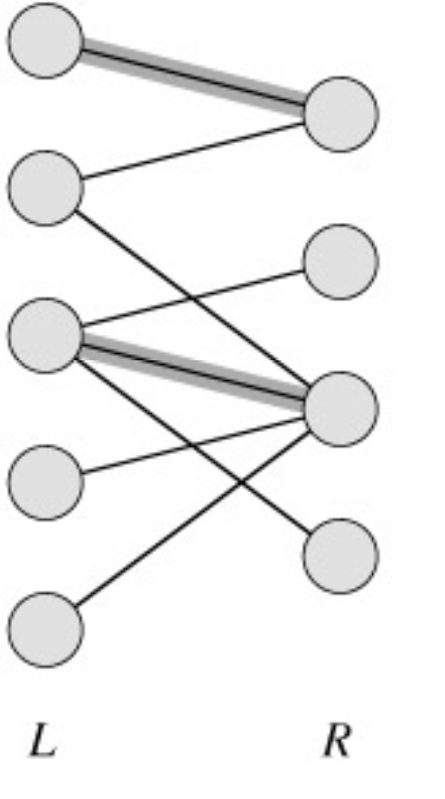
Maximum Bipartite Matching
A bipartite graph is a graph G = (V,E) in which V can be partioned into two parts L and R such that every edge in E is between a vertex in L and a vertex in R.
e.g. vertices in L represent skilled workers and vertices in R represent jobs. An edge connects workers to jobs they can perform.

Slide 34
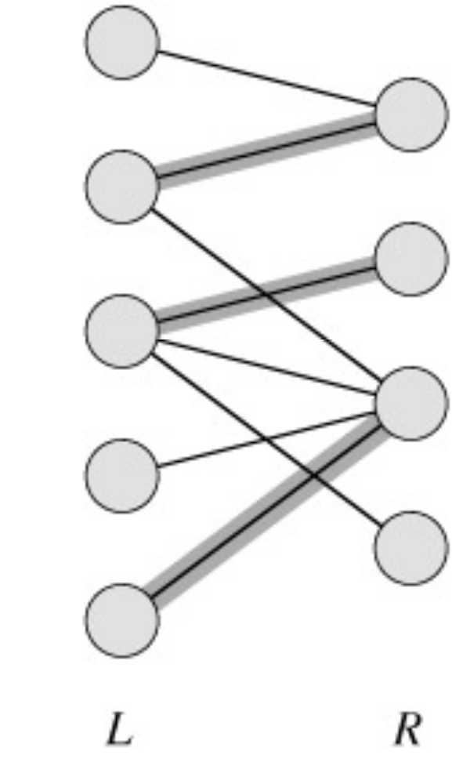
Matching
A matching in a graph is a subset M of E, such that for all vertices v in V, at most one edge of M is incident on v.

Slide 35
Maximum Matching
A maximum matching is a matching of maximum cardinality (maximum number of edges).
not maximum
maximum

Slide 36
Maximum Matching
No matching of cardinality 4, because only one of v and u can be matched.
In the workers-jobs example a max-matching provides work for as many people as possible.
v
u

Slide 37
Solving the Maximum Bipartite Matching Problem
Reduce the maximum bipartite matching problem on graph G to the max-flow problem on a corresponding flow network G’.
Solve using Ford-Fulkerson algorithm.

Slide 38
Corresponding Flow Network
To form the corresponding flow network G' of the bipartite graph G:
  Add a source vertex s and edges from s to L.
  Direct the edges in E from L to R.
  Add a sink vertex t and edges from R to t.
  Assign a capacity of 1 to all edges.
Claim: max-flow in G' corresponds to a max-bipartite-matching on G.
G
→G’
1
1
1
1
1
1
1
1
1
s
1
1
t
1
1
1
1
L
R

Slide 39


Solving Bipartite Matching as Max Flow

Slide 40
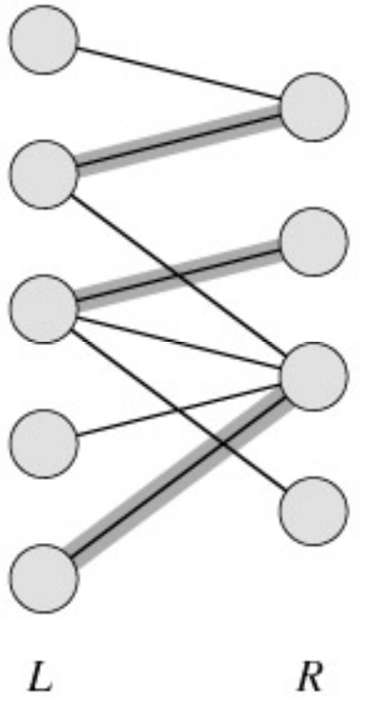
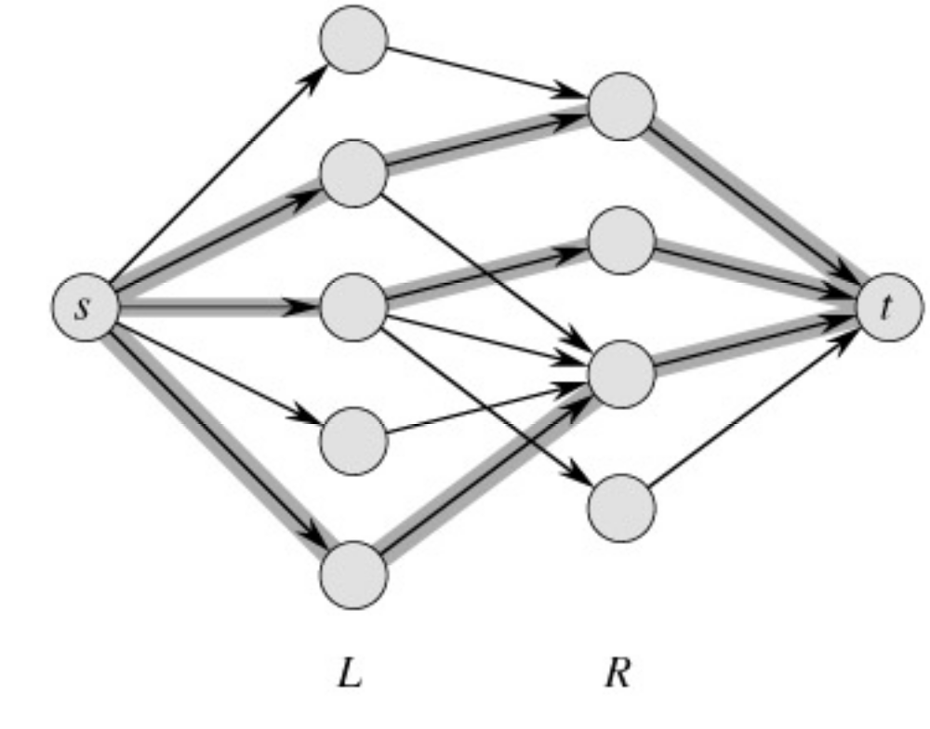
Example
min cut
|M| = 3 ←→ max flow =|f|= 3

Slide 41
Conclusion
Network flow algorithms allow us to find the maximum bipartite matching fairly easily.
Similar techniques are applicable in other combinatorial design problems.

